Slide 1

COMPUTATIONAL ENGINEERING MECHANICS PROJECT

Slide 2
GROUP MEMBERS(GROUP NO-5)
NAME | ROLL NO
VANGAPANDU RITHIN CHAND | AM.EN.U4AIE21174
SYED MUHAMMED TAHIR | AM.EN.U4AIE21163
SREENANDANA NANDAKUMAR | AM.EN.U4AIE21161
ADITHYA D VARMA | AM.EN.U4AIE21104

Slide 3
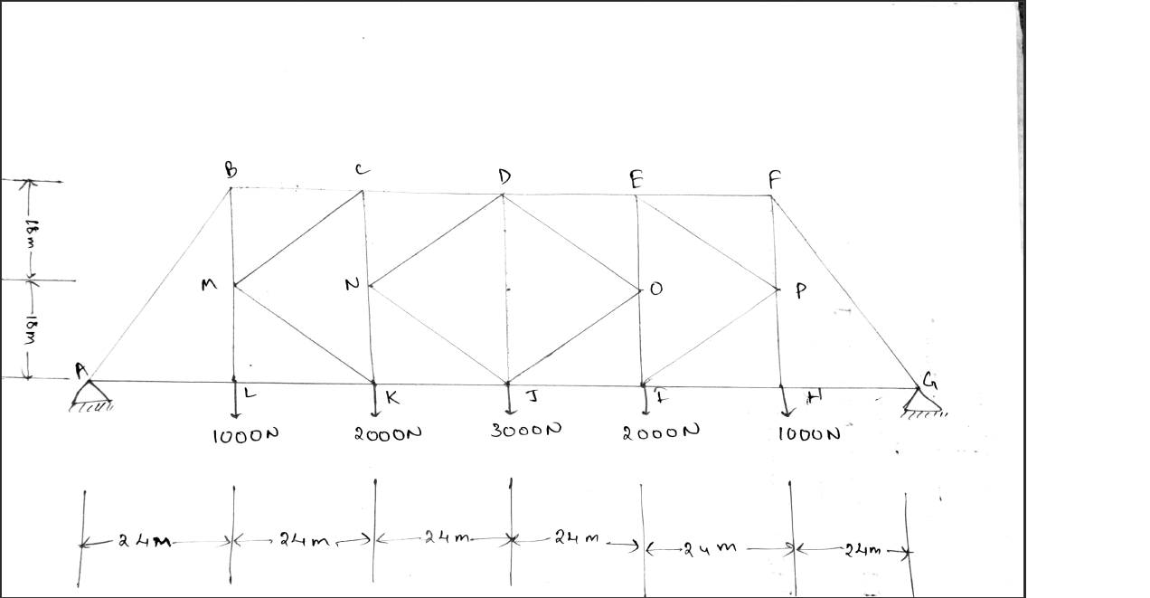
Question 1
Using MATLAB find all the member forces shown in bridge figure. Find the analytical solution for the case below
CONCEPT:
Method of Joints

Slide 4
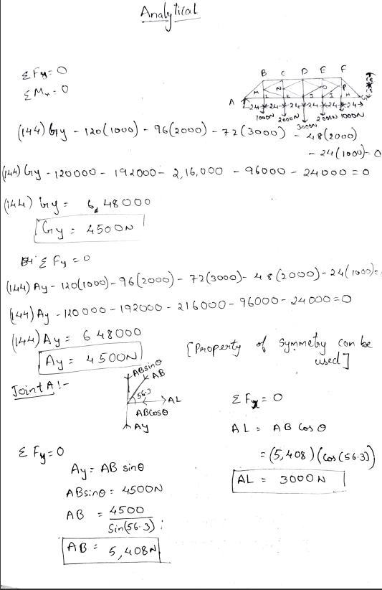
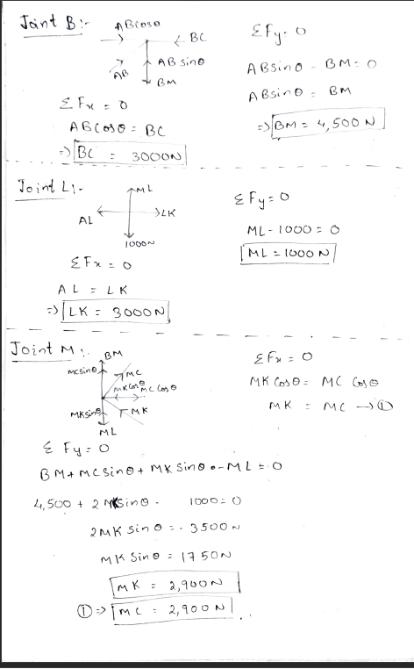
ANALYTICAL PART Q1

Slide 5
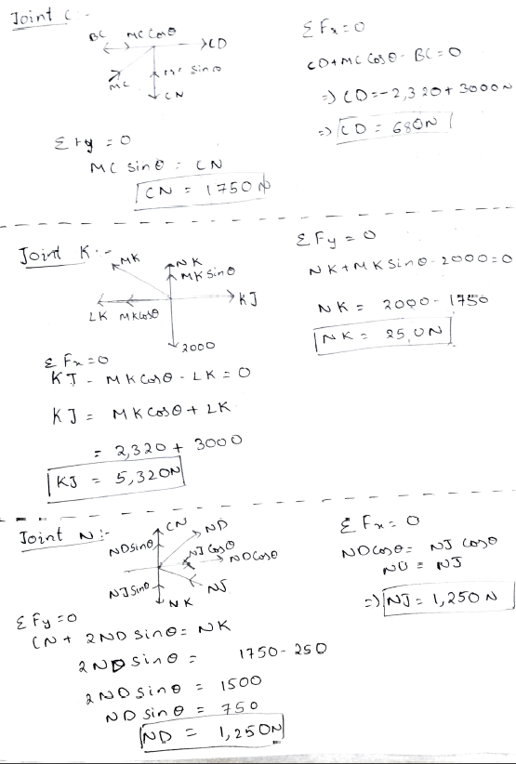
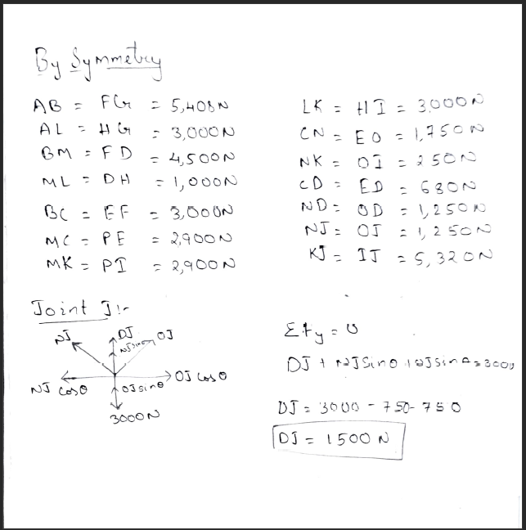

Slide 6
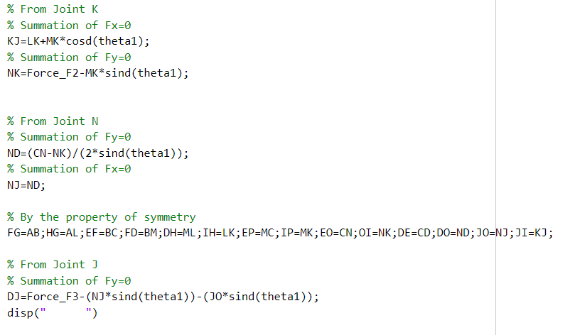
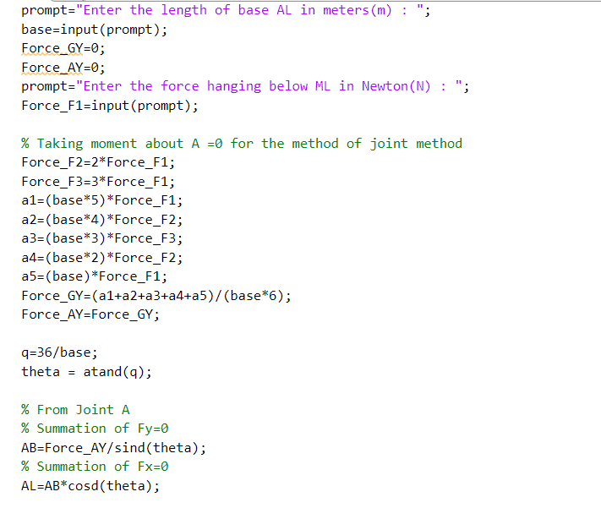
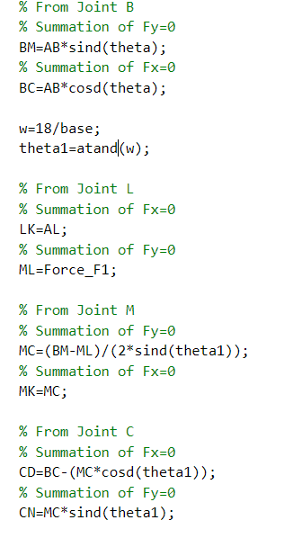
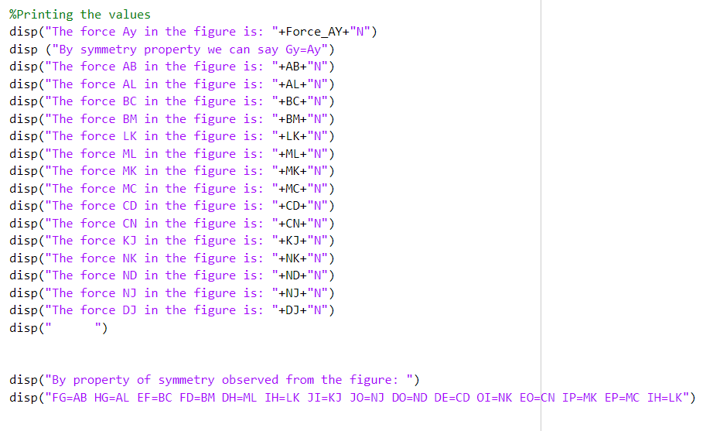
MATLAB CODE

Slide 7
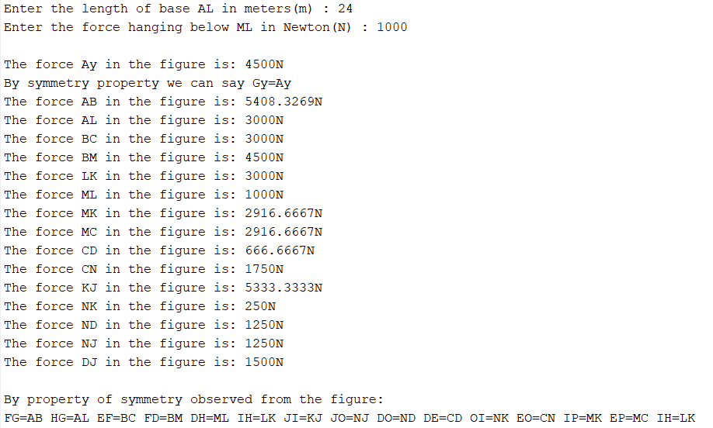
All the member forces have been calculated and printed from the user inputed values

Slide 8
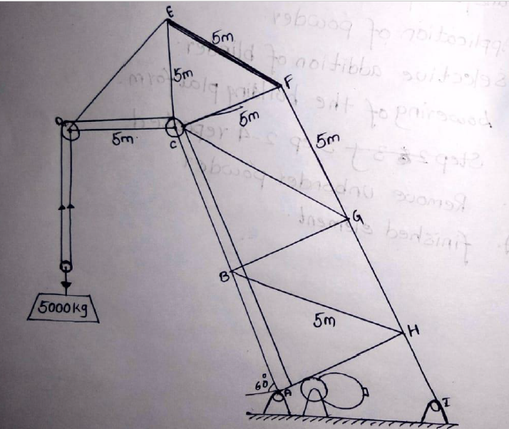
Question 2
Using MATLAB take user input for the dimension of the crane shown below and plot a graph showing the variation of member forces CB, CG, FG for any load varying from 0kN to 10kN for the given input. Also find the analytical solution for the case shown below
CONCEPT:
Method of Sections

Slide 9
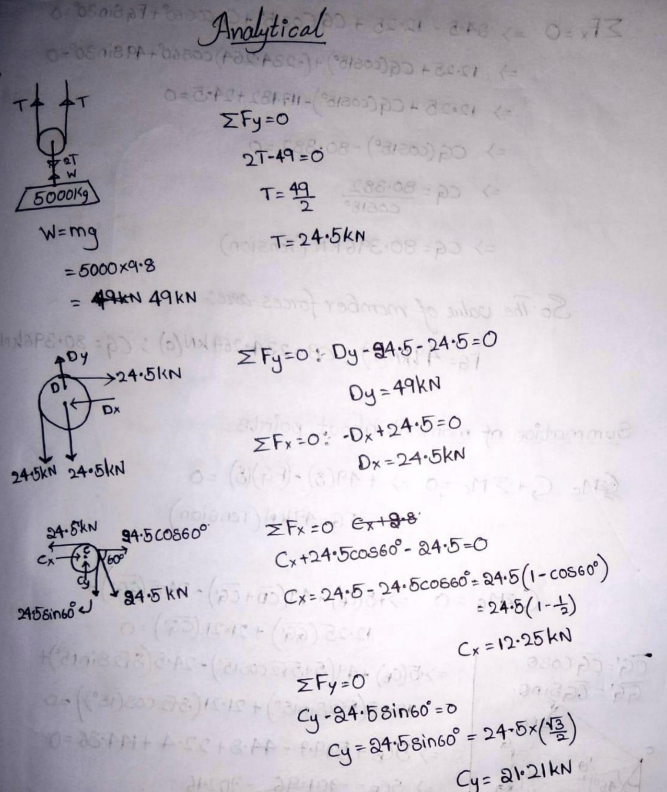
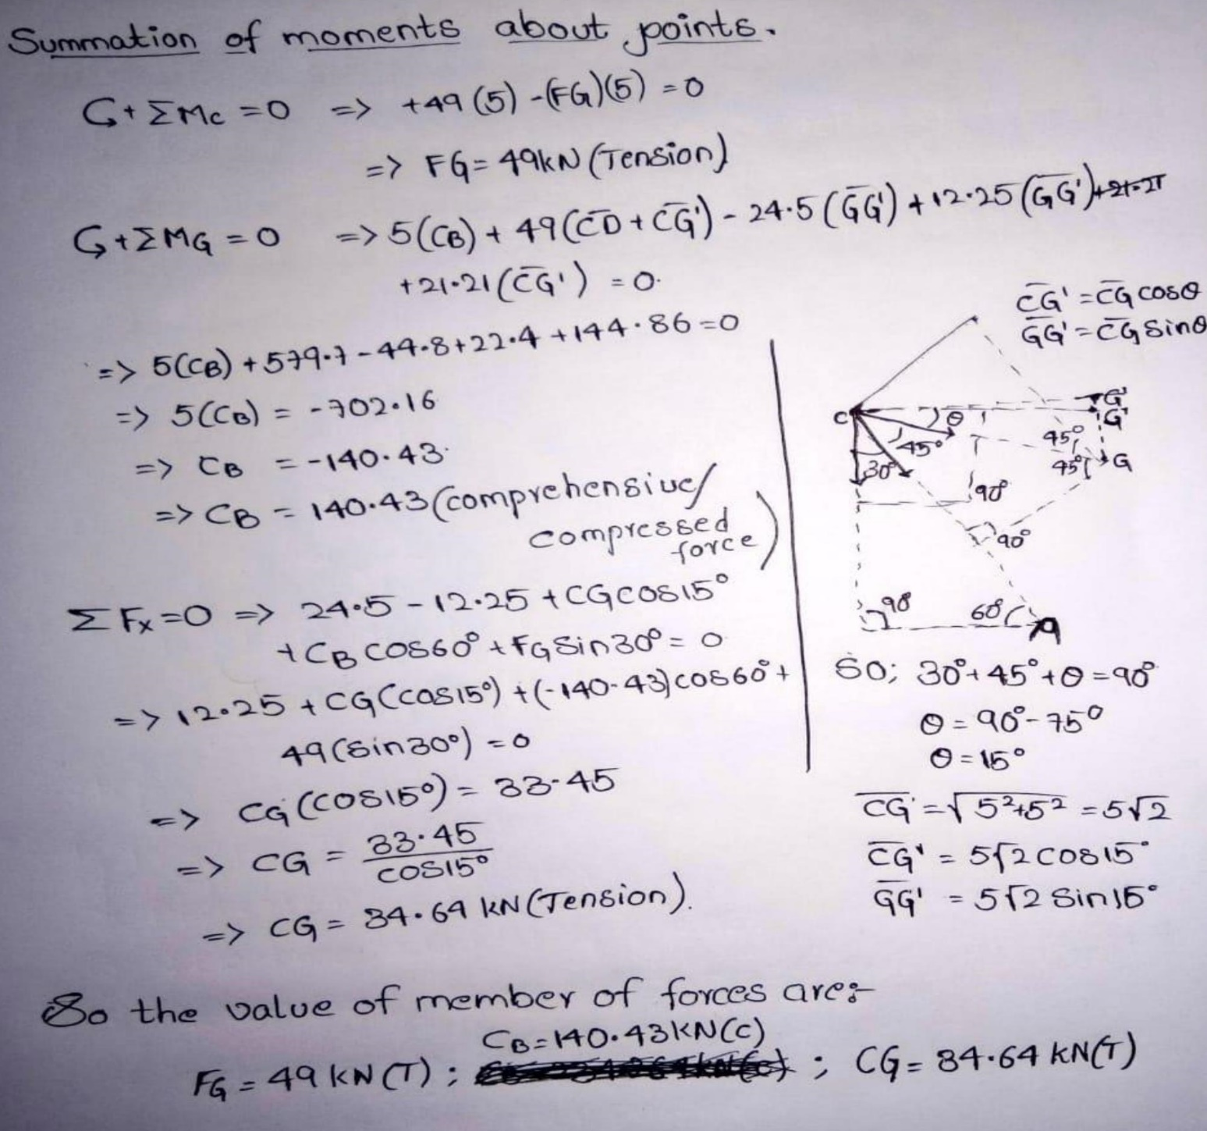
Analytical part Q2

Slide 10
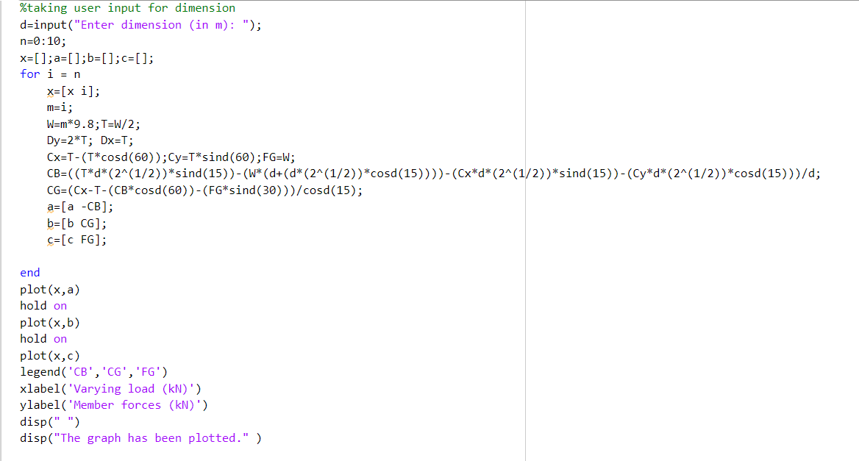
MATLAB CODE

Slide 11
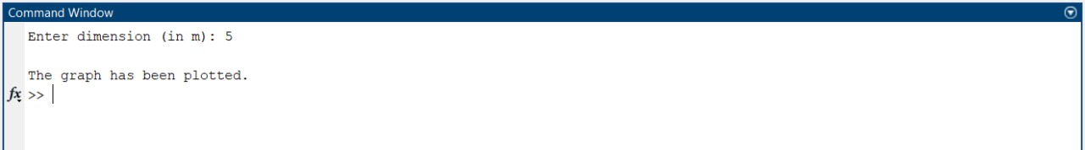
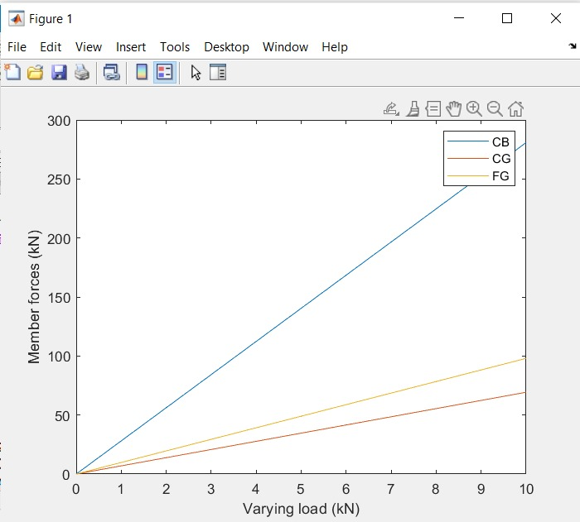
Graph is plotted for varying member forces when the load is varying from 0 to 10 kN

Slide 12
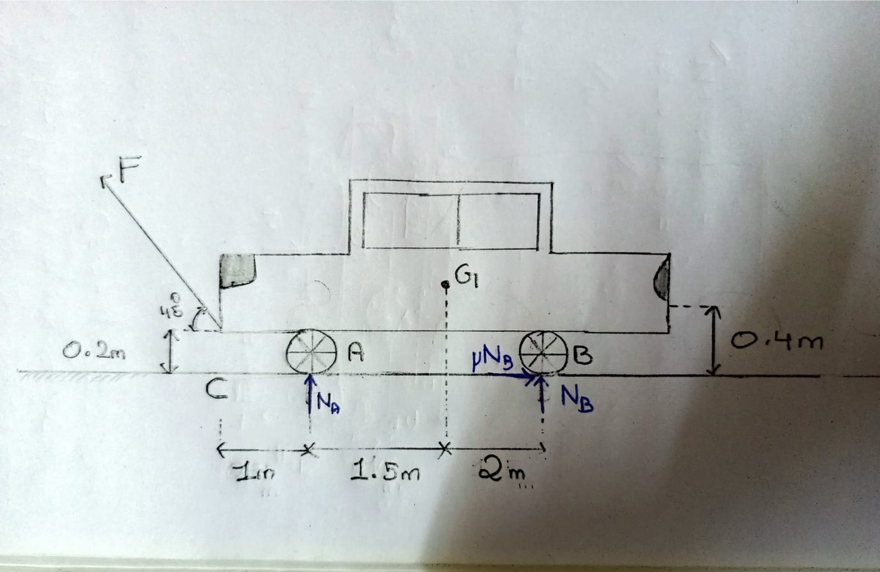
Question 3
Using MATLAB determine the towing force F required to move the car which has a COM at G for any user input as shown in the case below , provided the back brake are locked and front wheels are free to roll. (Take µ=0.3).Also calculate analytical solution for the case below and take mass of car as 2000kg
CONCEPT:
Friction

Slide 13
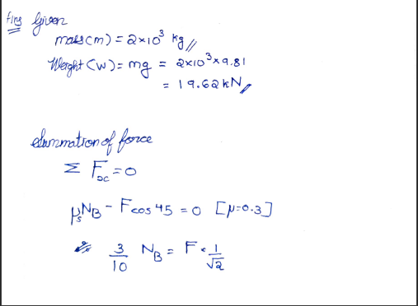
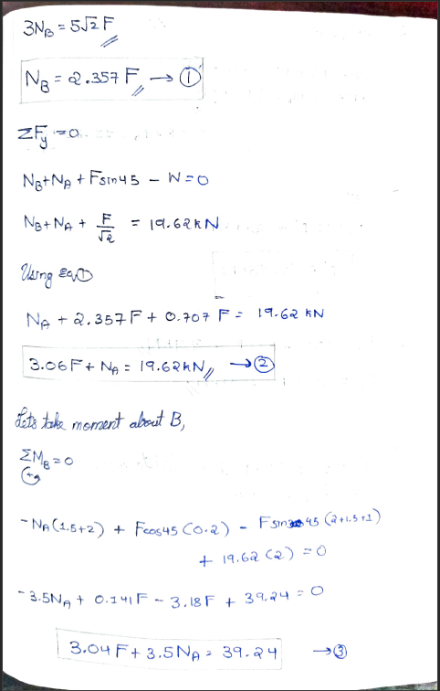
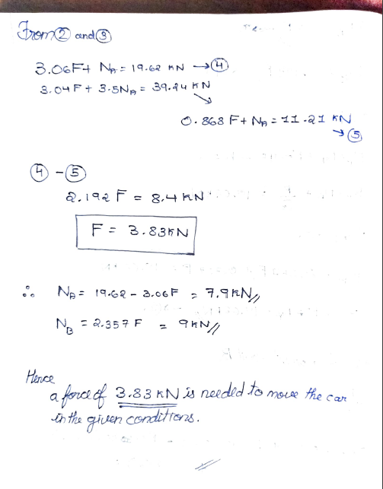
Analytical Part Q3

Slide 14
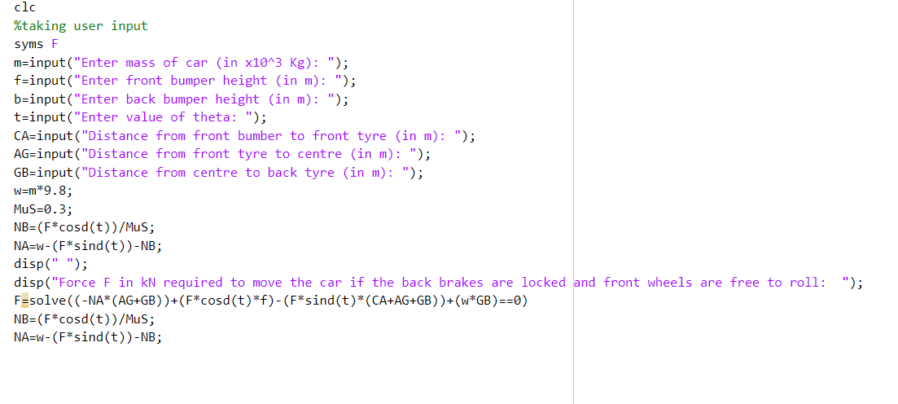
MATLAB CODE

Slide 15
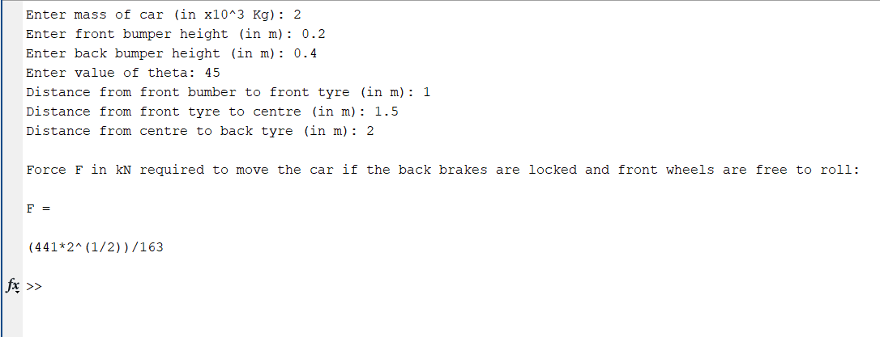
Towing force F(in kN) is calculated for the given inputs

Slide 16
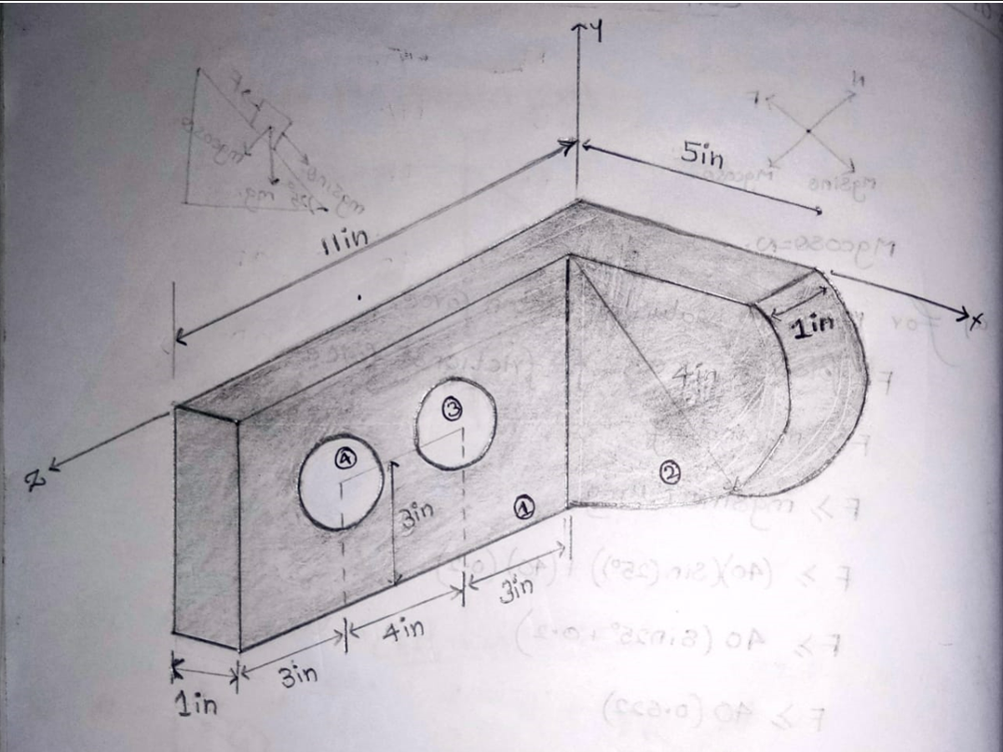
QUESTION 4
Using MATLAB, take user inputs for height, width, length, radius of the holes and distance between the centre of the holes find the centroid of the composite 3D figure. Also find the analytical solution for the case below
CONCEPT:
Centroid

Slide 17
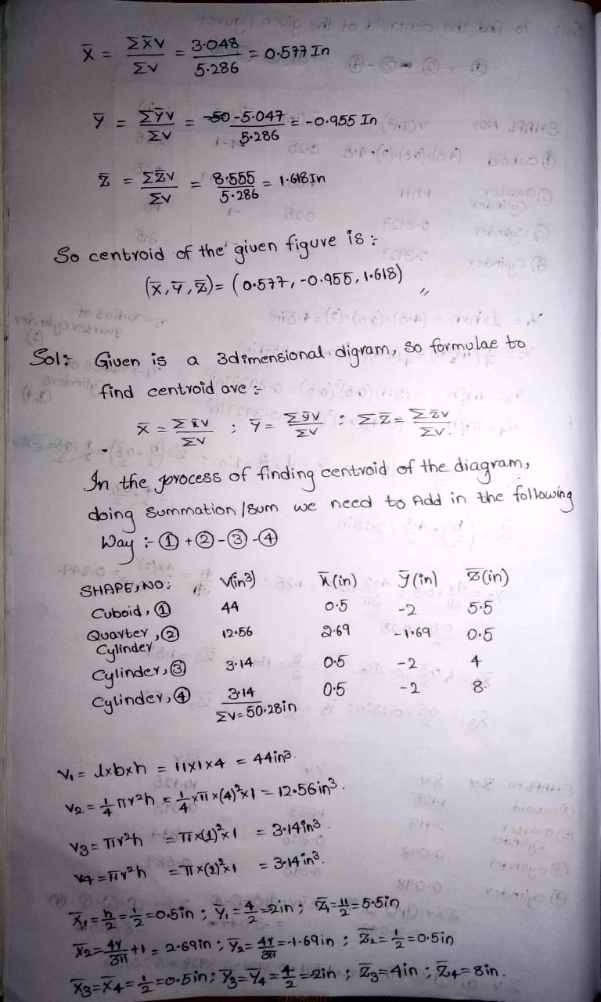
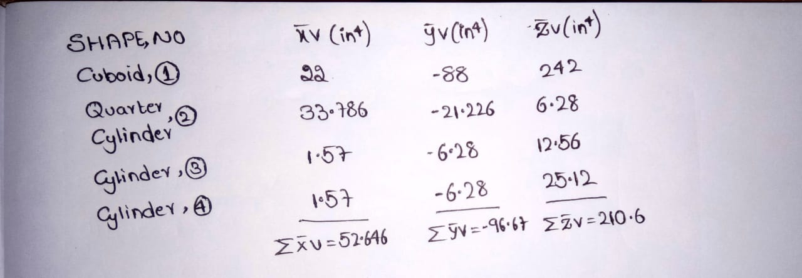
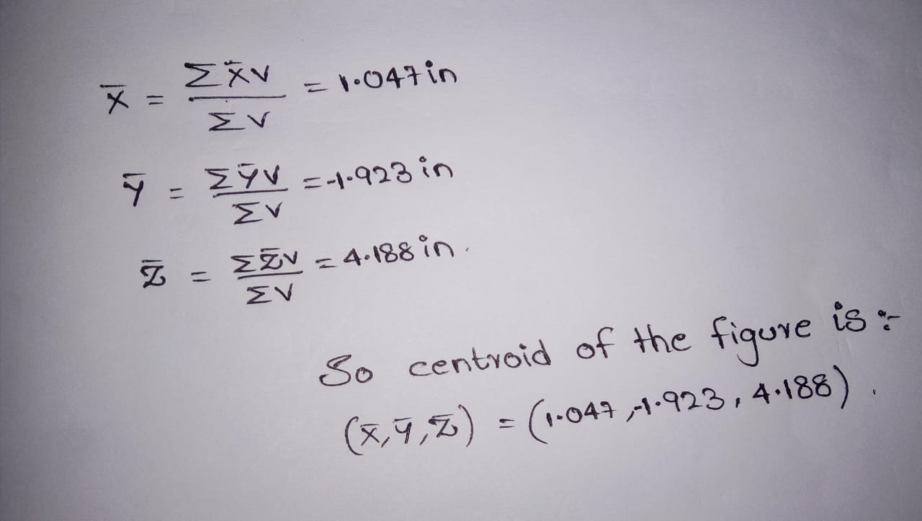
Analytical Part Q4

Slide 18
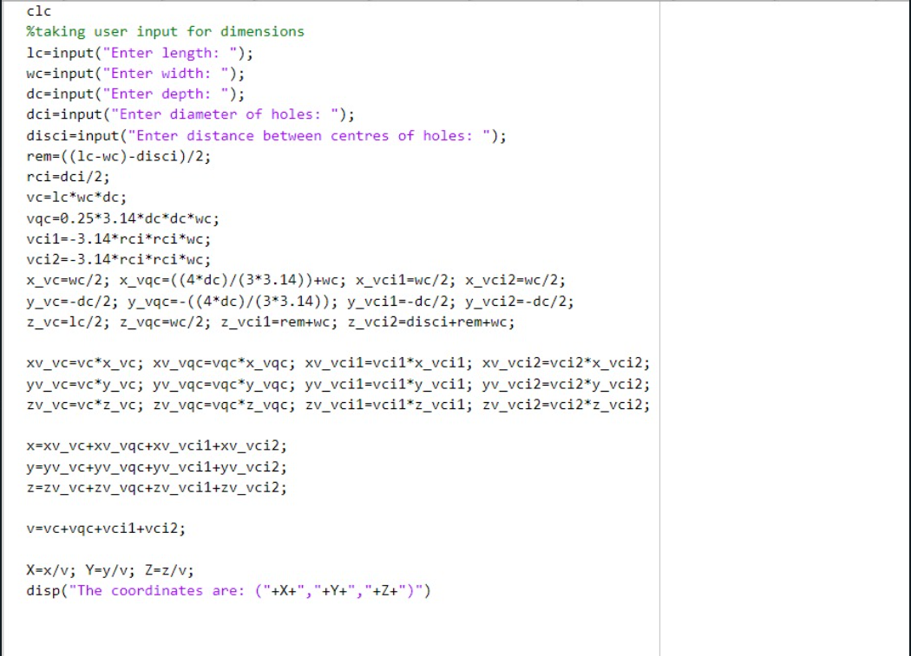
MATLAB CODE

Slide 19
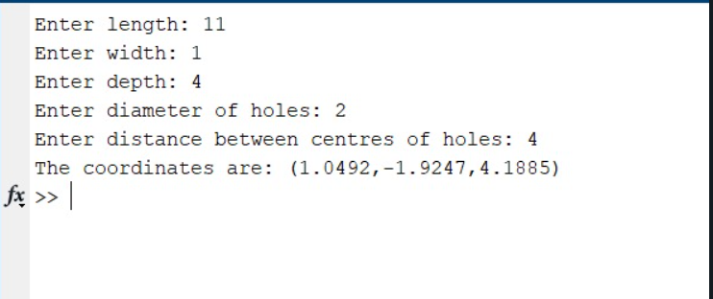
Coordinates of centroid of the 3D shape is found for the given inputs

Slide 20
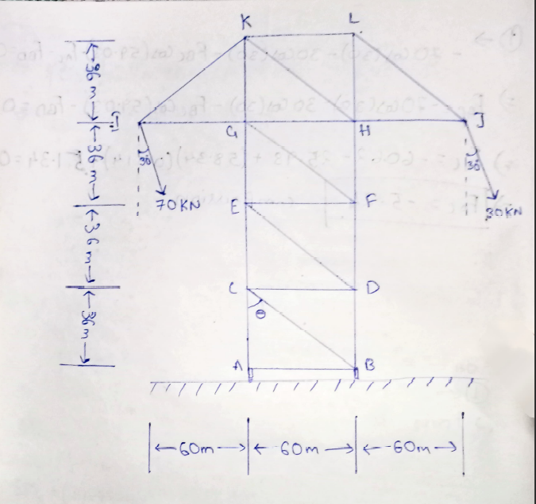
QUESTION 5
Using MATLAB, take user input for the dimensions of the tower, forces and the angle and generate a graph showing the relation between member forces and θ when θ is varied from 0 to 90 degree for that given dimension. Find the analytical solution for the case given below
CONCEPT:
Method of Sections

Slide 21
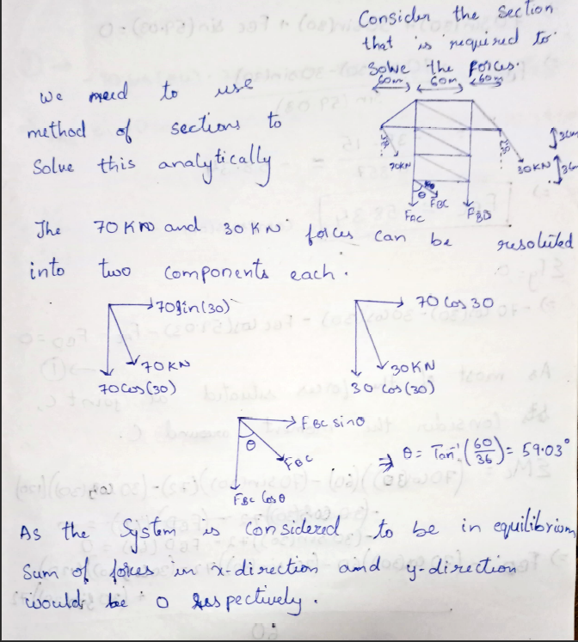
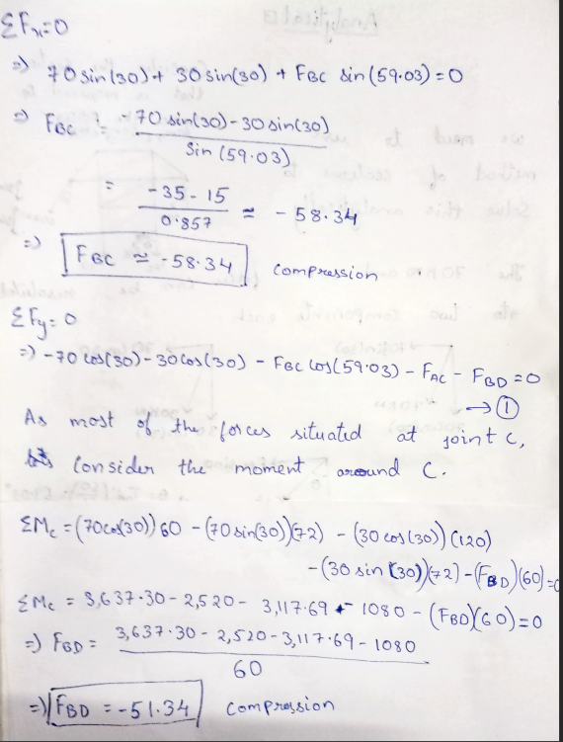
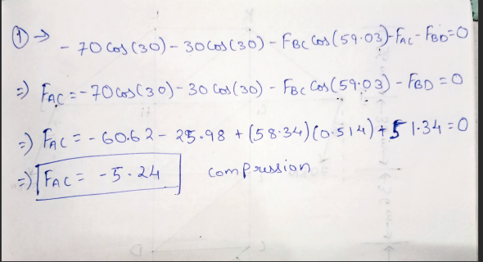
Analytical Part Q5

Slide 22
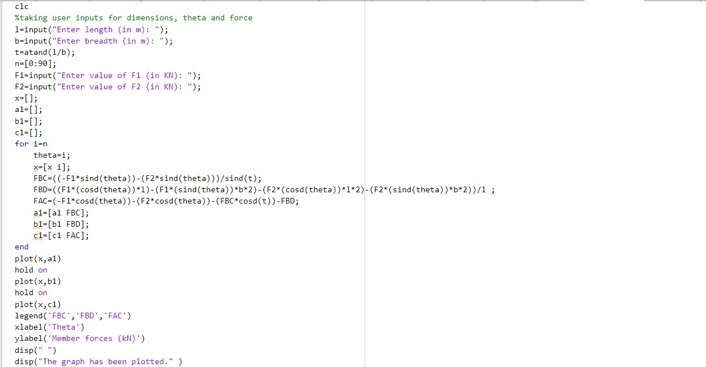
MATLAB CODE

Slide 23
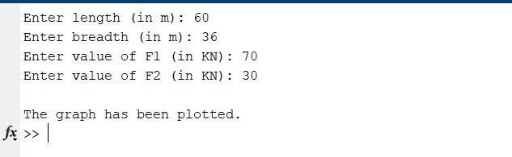
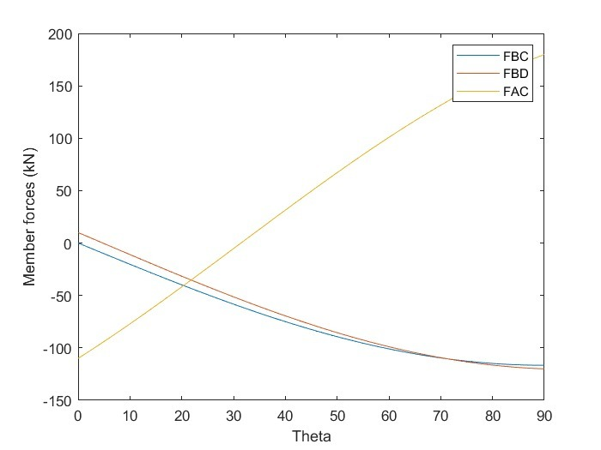
Member forces with varying θ(0 to 90) has been plotted

Slide 24
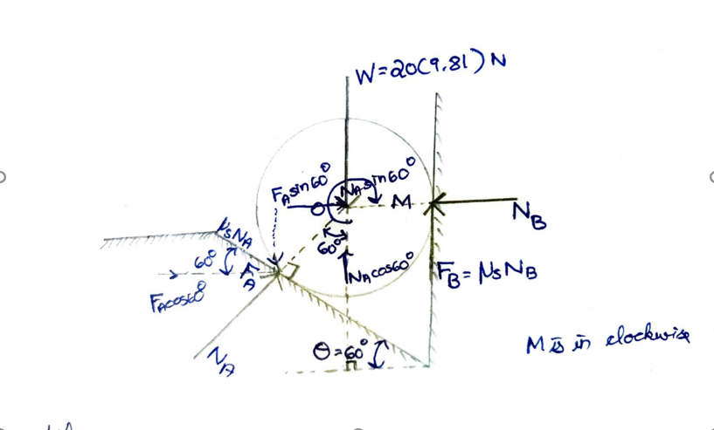
QUESTION 6
Using MATLAB take user input for the mass ,diameter of the cylinder and the angle of inclination(0-90 degrees) and calculate the clockwise couple M which cause the cylinder to slip. Also find the analytical solution for mass(m)=20kg and diameter(d)=0.5m and θ=60 degrees (Take µ =0.3)
CONCEPT:
Couple

Slide 25
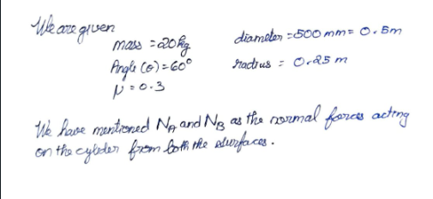
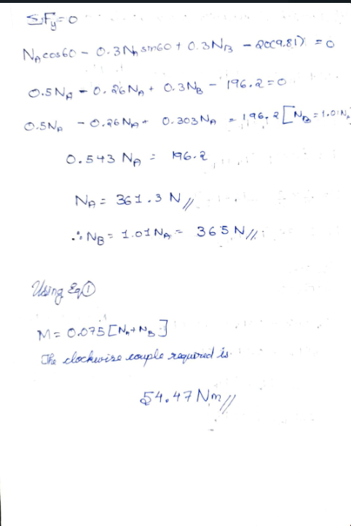
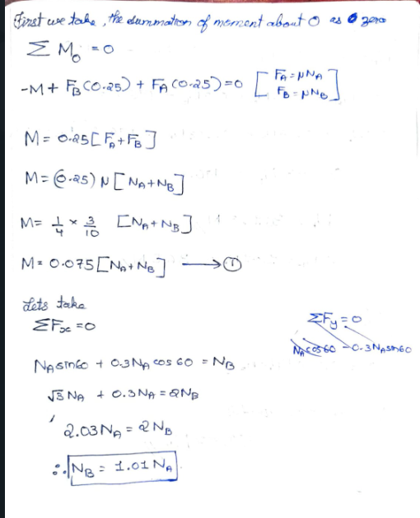
Analytical Part Q6

Slide 26
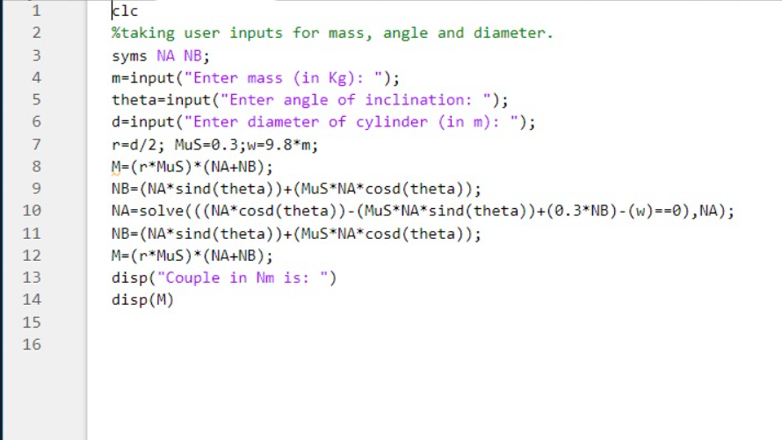
MATLAB CODE

Slide 27
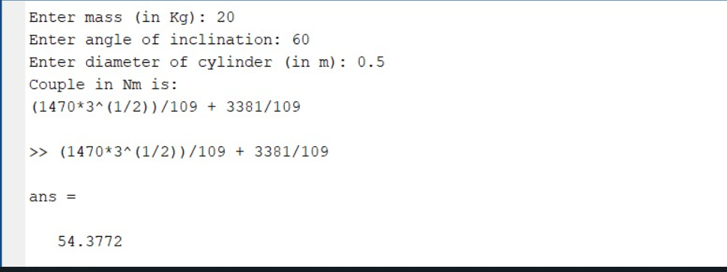
Clockwise moment is calculated from the input values of mass, angle and diameter.

Slide 28


